Slide 1
Echopype
An open-source software for
converting echosounder data to NetCDF4

Slide 2
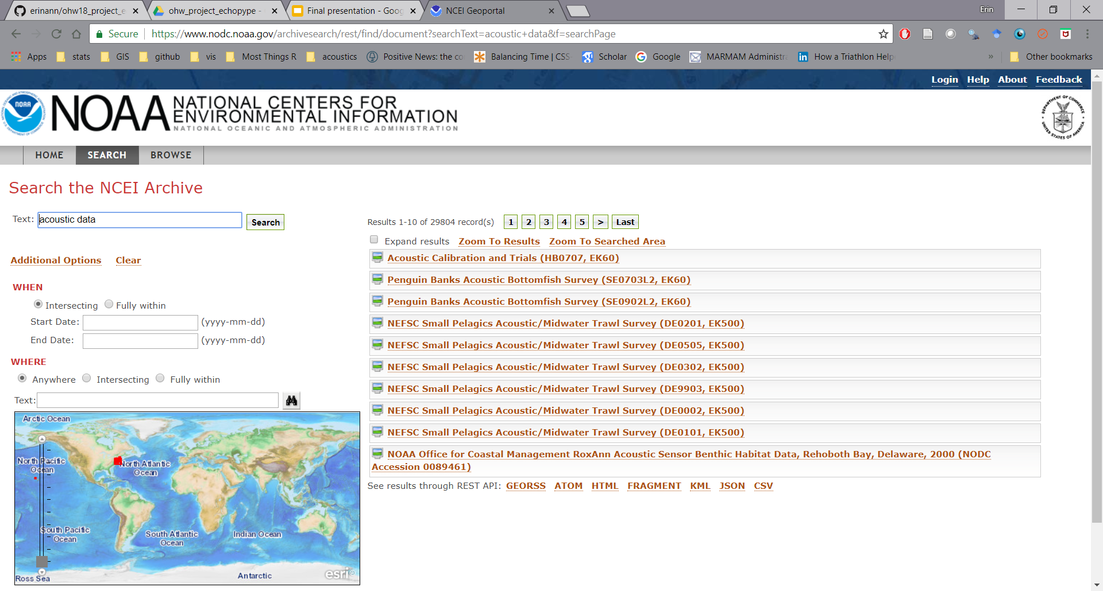
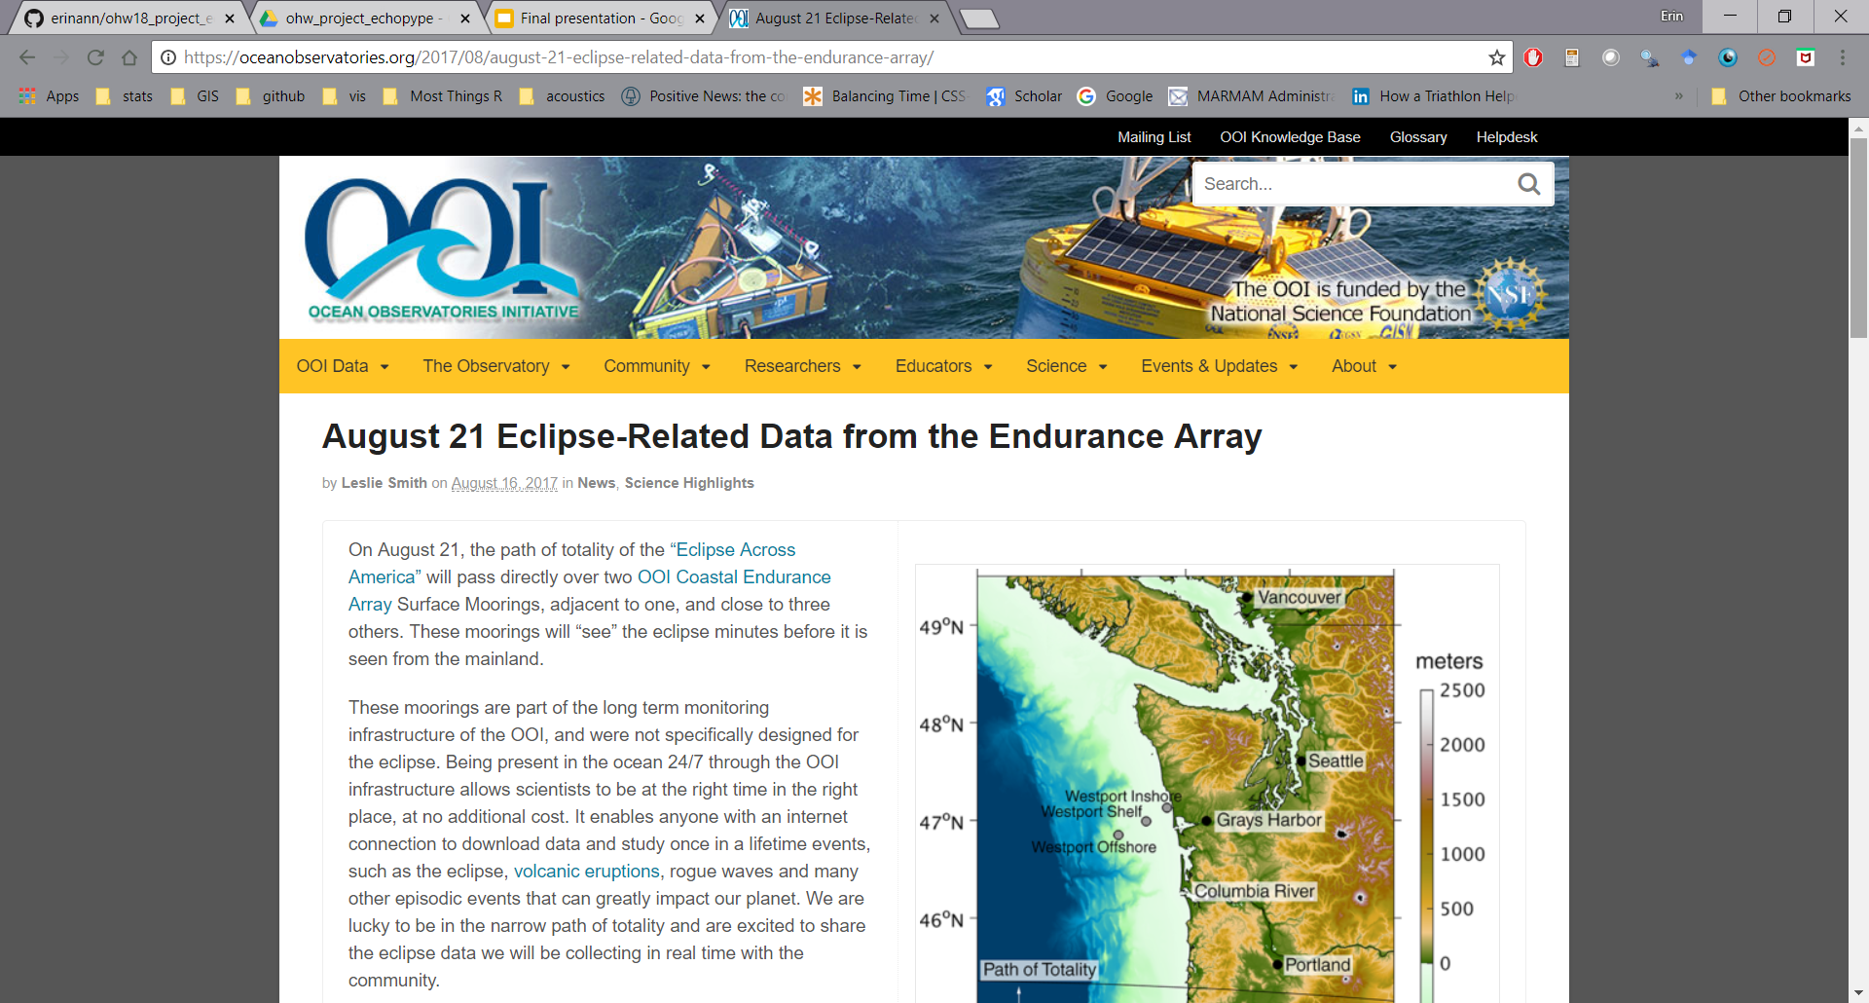
Why?/What?
Lot’s of acoustic data available on OOI/IOOS platforms + vessels of opportunity
HOW do we access it?
What are echosounder data?
Discrete Frequency (Continuous wave)
Broadband (Frequency modulated)
How is it collected?
-Ship-based EK60, EK80
-Moorings and Autonomous platforms - AZFP, WBAT
Stored in Proprietary formats (.Raw, .01A, etc.)

Slide 3
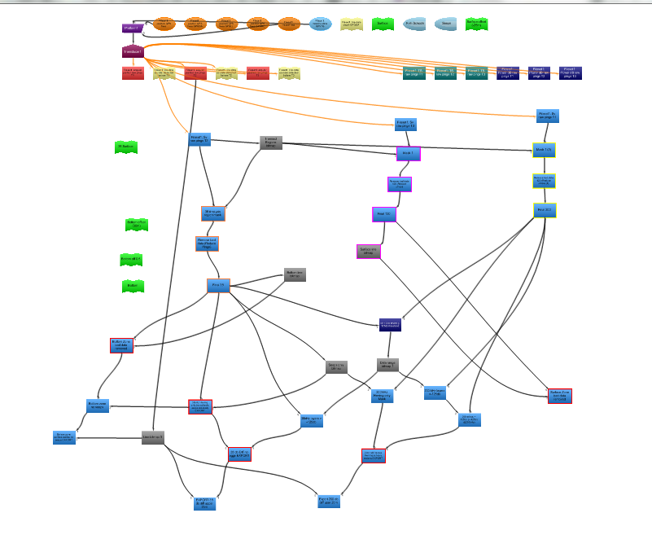

Objective/So What?
Proprietary Software is useful, but expensive (Echoview)
Open-source package that converts all these formats to NetCDF4
International Council for the Exploration of the Seas (ICES) convention
Easily usable for scientists, reproducible methods, standard for database storage

Slide 4
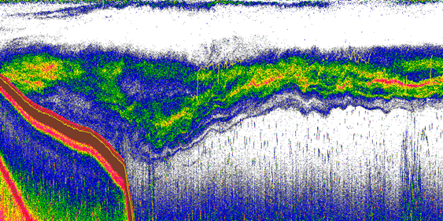
What is acoustic data?

Slide 5
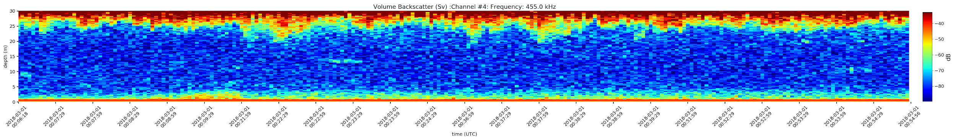
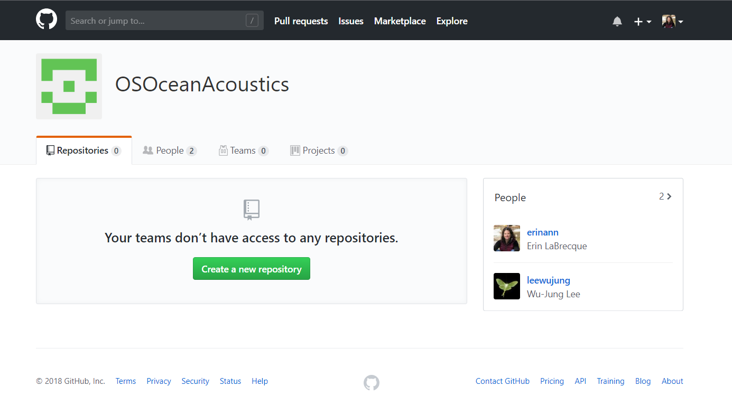
Accomplished this week
Merge existing codes (in Python and Matlab)
Fix bugs
Use Github to keep our versions straight
During the week, Mark was able to debug existing code for AZFP and produce this echogram:
Set up OSOcean Acoustics Group on Github to keep working...

Slide 6
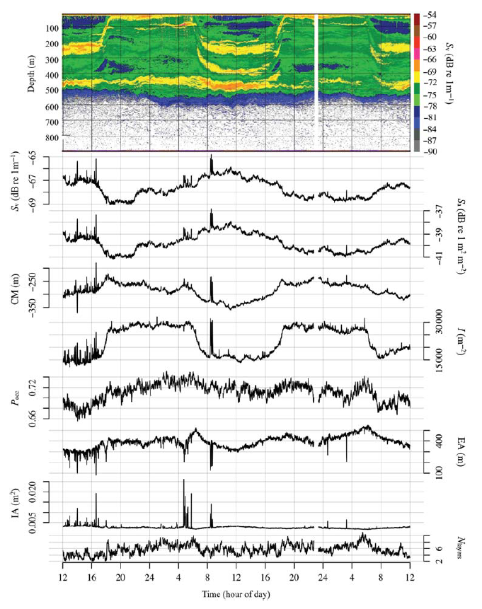
What’s Next?
Contribute to previous efforts - Pyecholab, EchoR
Keeping building open-source package for acoustic data analysis.
Use global acoustic data to develop and measure indices of change
Urmy et al. 2012

